Slide 1

УЗНАЙ СВОИХ
Православное молодёжное паломничество-поход
KNOW YOUR OWN
Orthodox Youth Pilgrimage Hike
ADOYC GROUP 4
Team leader: Marietta Avanesian,
Team Members: Timofei Beletsky, Polina Bolberov, Marat Chernov,
Ilya Chernjawsky, Olesya Kalashnikova, Pavel Lisenkov, Stephan Loukianoff, Emilia Metlenko, Kate Ohotin.

Slide 2
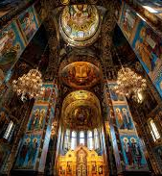

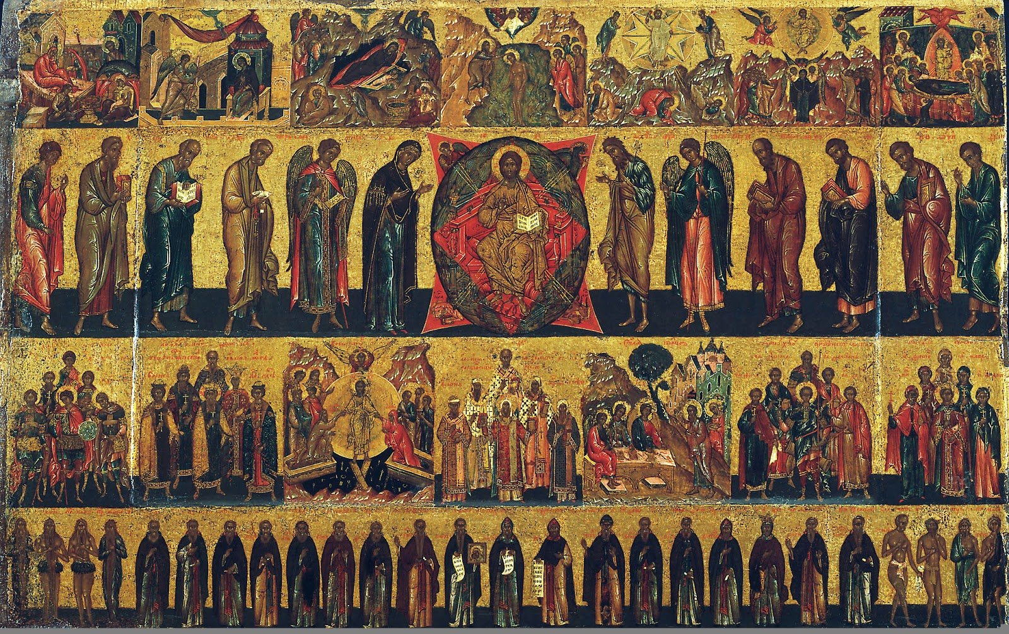
Знакомство с местными святыми
Discovering our local saints
Notes:
problematic slide with photos from parish life candles ect

Slide 3
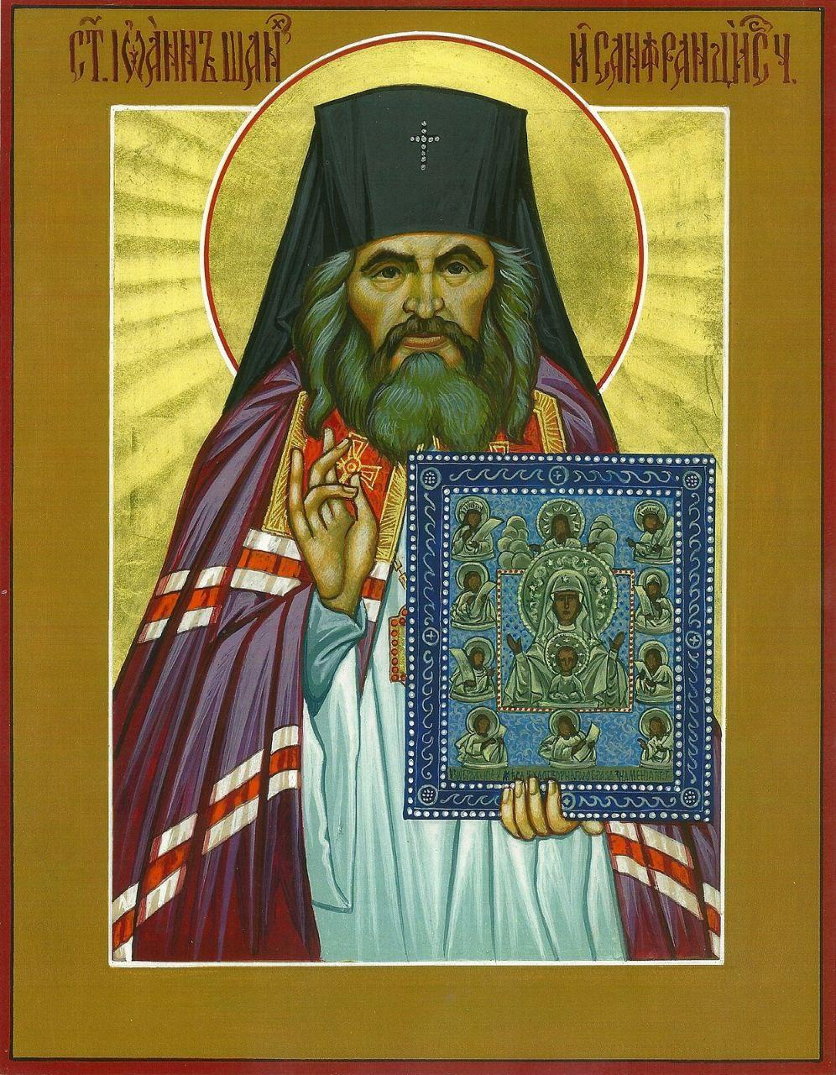
Notes:
problematic slide with photos from parish life candles ect

Slide 4
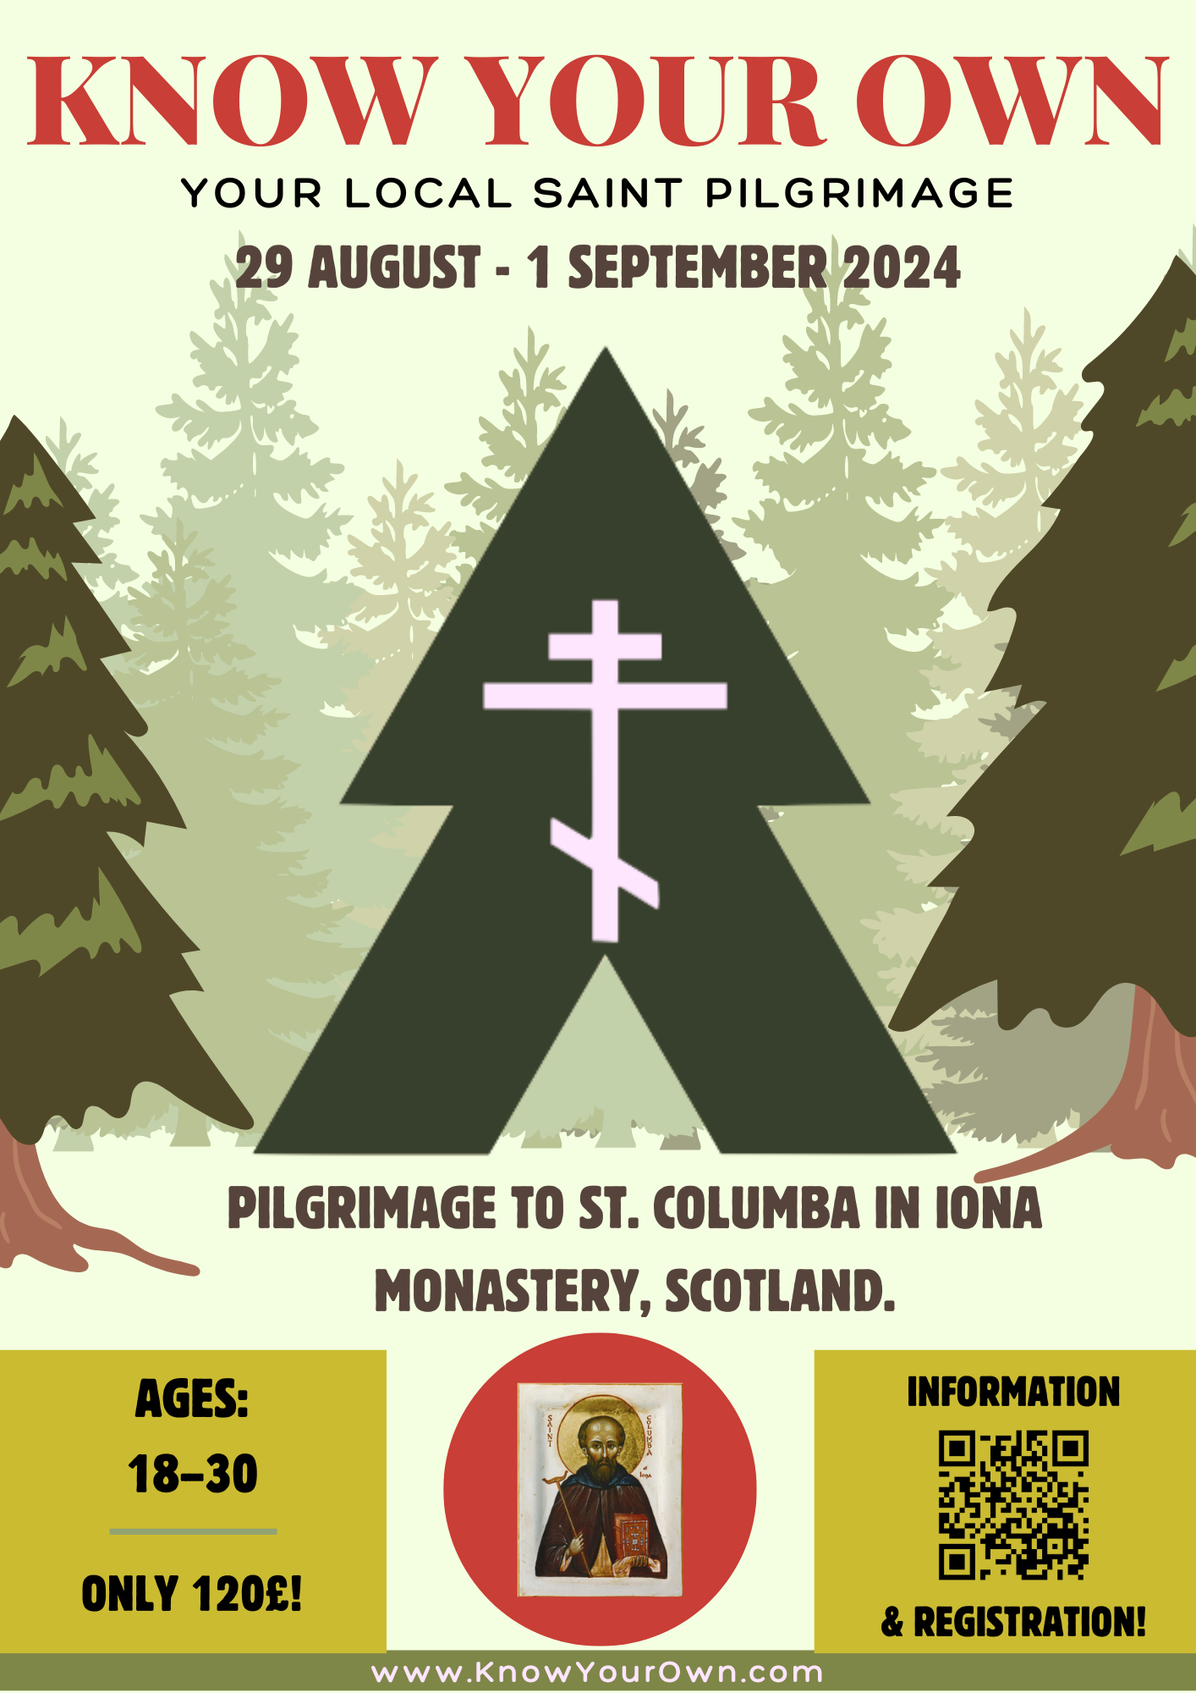

poster плакат

Slide 5
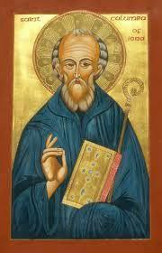
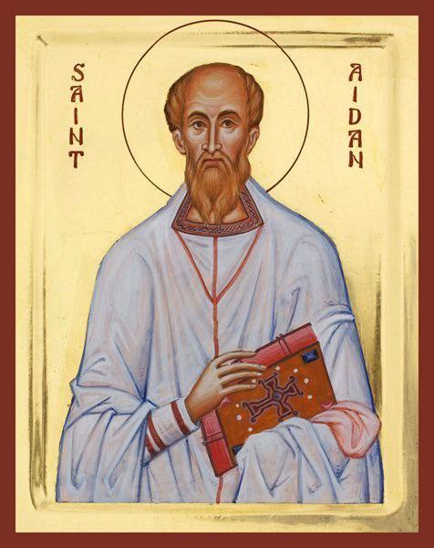
Saint Columba
Святой Колумба
Saint Aidan
Святой Айдан
Enlightener Monk of Iona
Founded Monastery Lindisfarne (which helped in large conversion of Northern England
Монах-просветитель
Ионы Основал монастырь Линдисфарн (который помог в большом обращении Северной Англии)
Enlightener and Apostle to the Scots
Founded Monastery of Iona (which founded 13 saints)
Просветитель и апостол шотландцев
Основал монастырь Айона (в котором было основано 13 святых)

Slide 6
project goals цели проекта
польза для духовной жизни
интеллектуальное развитие
активный отдых
социальное развитие, знакомство со сверстниками
gaining benefits for one's spiritual life
intellectual pursuits
active recreation
social development, meeting peers
Notes:
later in deck

Slide 7

planning process процесс планирования
  Заранее: согласовываем приезд с обществом Historic Scotland, приглашаем священника
  За три месяца: создаем команду организаторов, распределяем обязанности
  За два месяца: составляем смету бюджета, разрабатываем маршрут
  За полтора месяца: распространяем объявление и запускаем регистрацию
  За неделю: определяем состав участников
  За день: закупаем еду
  In advance: coordinate the visit with Historic Scotland, invite a priest
  Three months ahead: form an organizing team, assign responsibilities
  Two months ahead: draft the budget, develop the itinerary
  One and a half months ahead: distribute the announcement and open registration
  One week ahead: finalize the list of participants
  One day ahead: purchase food

Slide 8

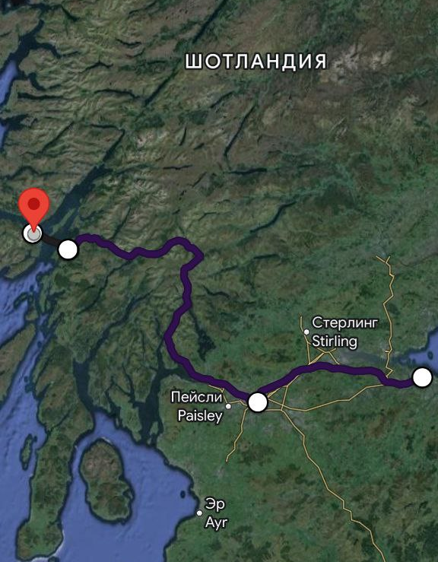
schedule расписание
Day 1:
7:00 meeting at the train station in Edinburgh
7:15 departure of the train to Glasgow
8:07 arrival in Glasgow
8:21 train to Oban
11:33 arrival in Oban
11:40 - 12:05 lunch at Food from Argyll at the Pier
12:15 departure of the ferry
13:05 ferry arrives
(1:30 bus till 2:30 if bad weather)
13:20 walk to Ardura
15:30 arrival at Ardura
16:00 dinner and rest at Ardura Campsite
Notes:
later in deck

Slide 9
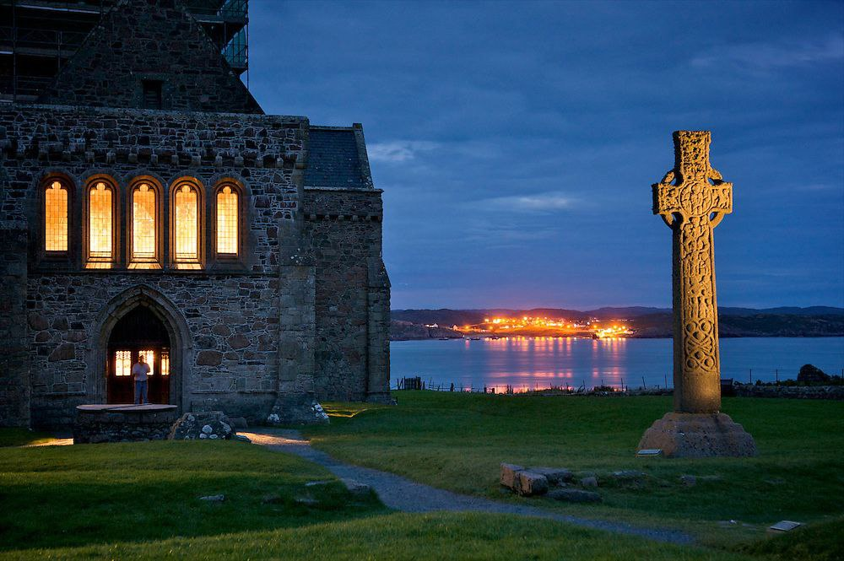
schedule расписание
Day 2:
6:00 Breakfast and set off towards
Fionnphort afterwards
12:00 - 12:40 Lunch
17:40 Arrival in Fionnhort
18:15 Ferry to Iona and dinner
Notes:
later in deck

Slide 10
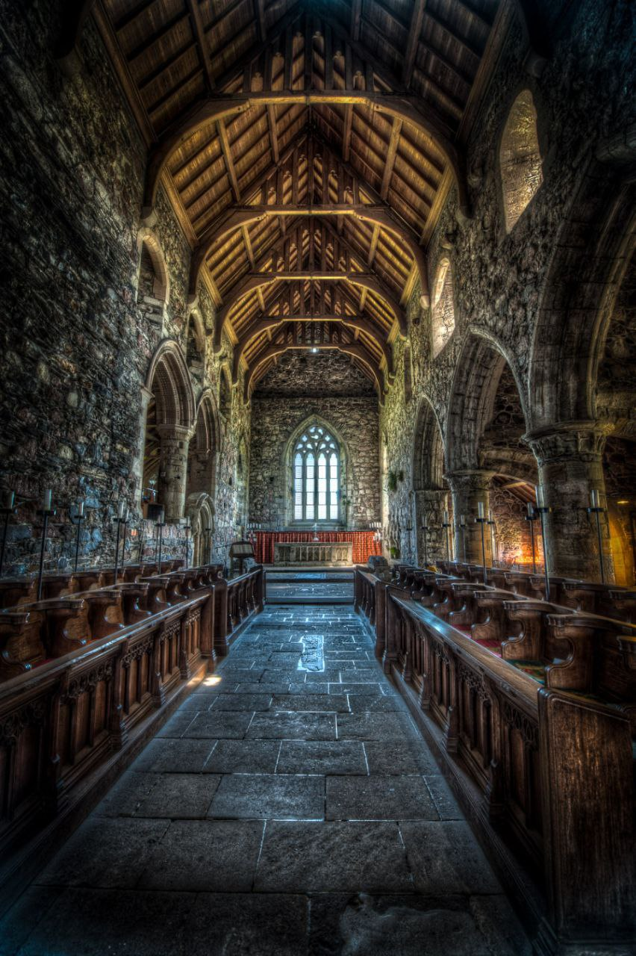
schedule расписание
Day 3:
10:00 Liturgy at the Monastery of Iona for the feast day of St Aidan
12:30 Lunch
13:00 Hike around the Island, visiting the Holy sites
of the Martyrs of Iona, visit to St Oran's grave and chapel
16:30 Return to the Iona Monastery
17:00 Dinner
18:00 Vespers
19:00 Free time and Bed
Notes:
later in deck

Slide 11
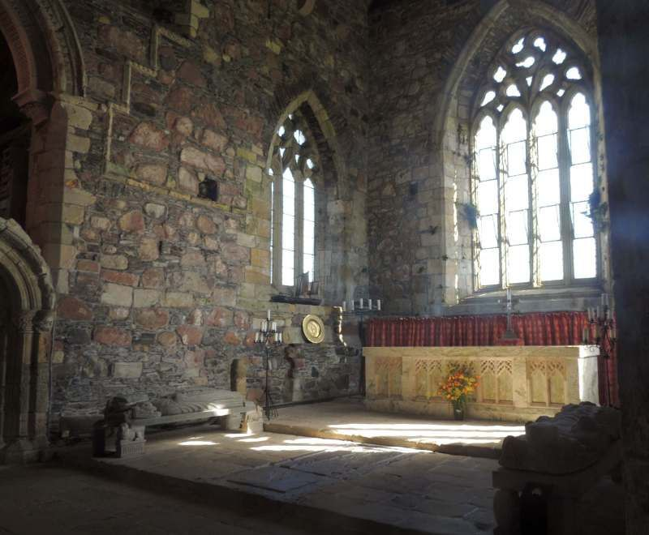
schedule расписание
Day 4:
10:00 Sunday Liturgy on Iona
12:00 Lunch
13:00 Free Time
14:00 Ferry to Fhionnphort
15:20 Fhionnphort to Craignure
16:30 Arrival at Craignure
17:05 Ferry to Oban
17:55 Arrival in Oban
18:05 Train to Glasgow
21:25 Arrival
21:45 Train to Edinburgh
22:20 Arrival at Edinburgh and end of Pilgrimage
Notes:
later in deck

Slide 12
как это может
(вероятно)
выглядеть…
what this may
(PROBABLY)
LOOK LIKE…
Notes:
later in deck

Slide 13

Notes:
later in deck

Slide 14
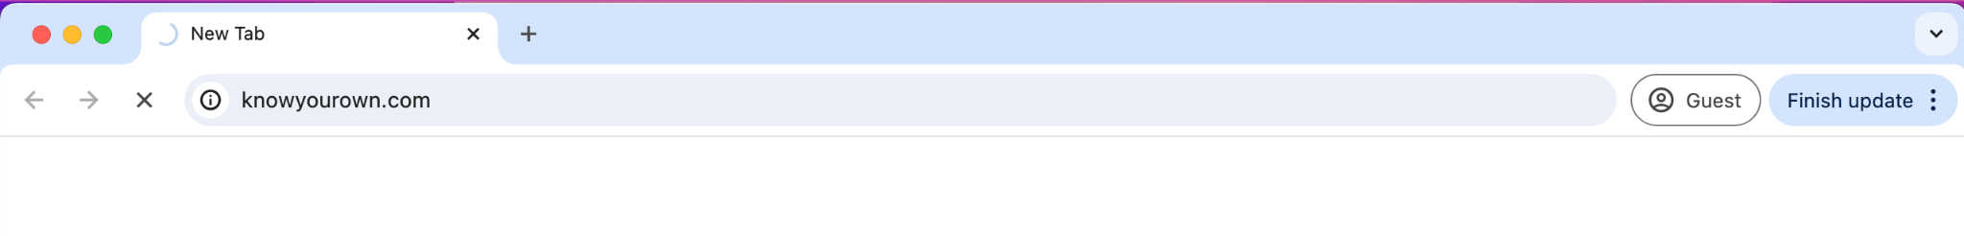
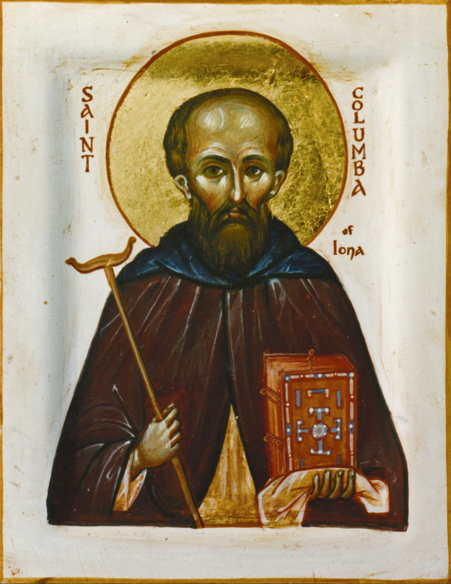
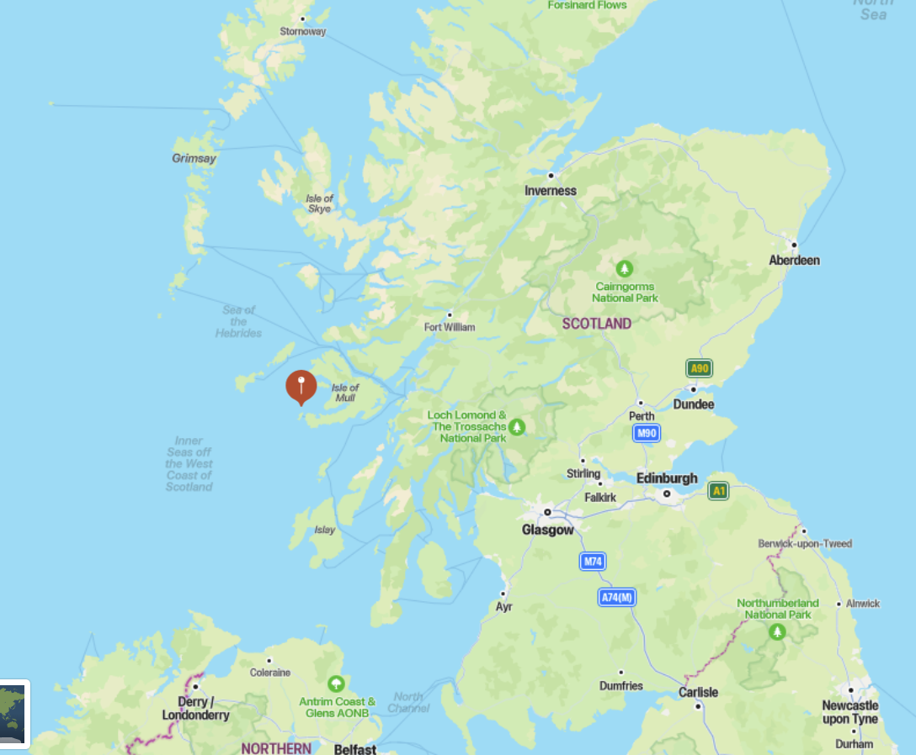
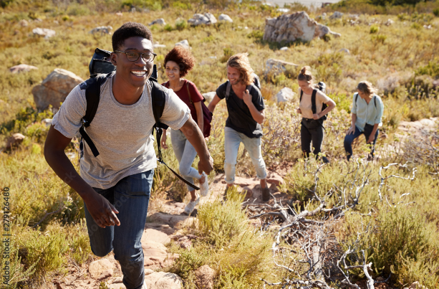
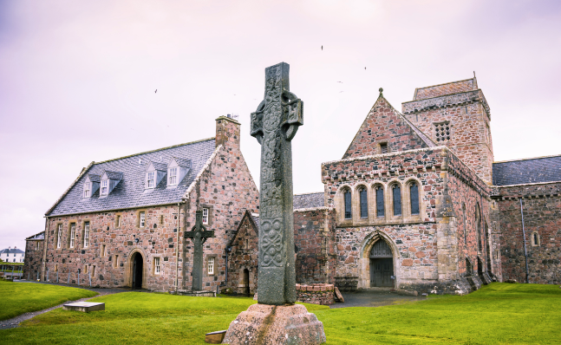
example catalogue пример страницы из каталога
Know Your Own
Isle of Iona on the map
Saint Columba of Iona
(Scotland)
St. Columba (born in 521 A.D. - died in 597 A.D.) is an Irish Saint who is credited with having had a main role in the conversion of Scotland to Christianity in the 6th Century. He is a patron saint of Scotland and one of the three patron saints of Ireland, along with St. Patrick and St. Brigid. He is also revered as the patron of the city of Derry, Northern Ireland; poets; and bookbinders and invoked against floods. Columba and his associates and successors spread the gospel more than any other contemporary group of religious pioneers in Britain.
PHOTOS FROM ‘24 PILGRIMAGE
Notes:
Stephan’s slide

Slide 15
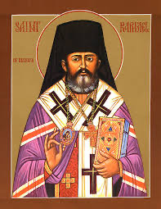
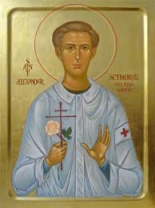
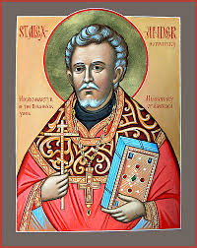
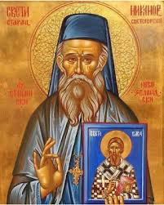
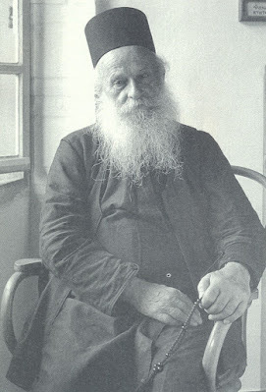
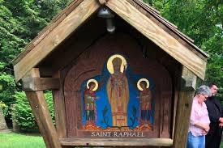
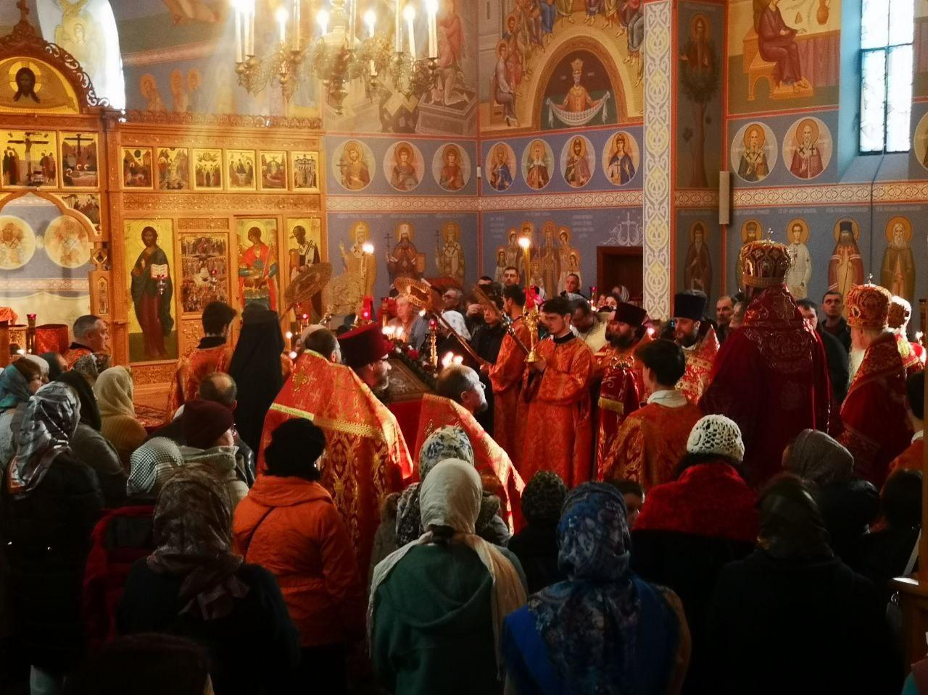
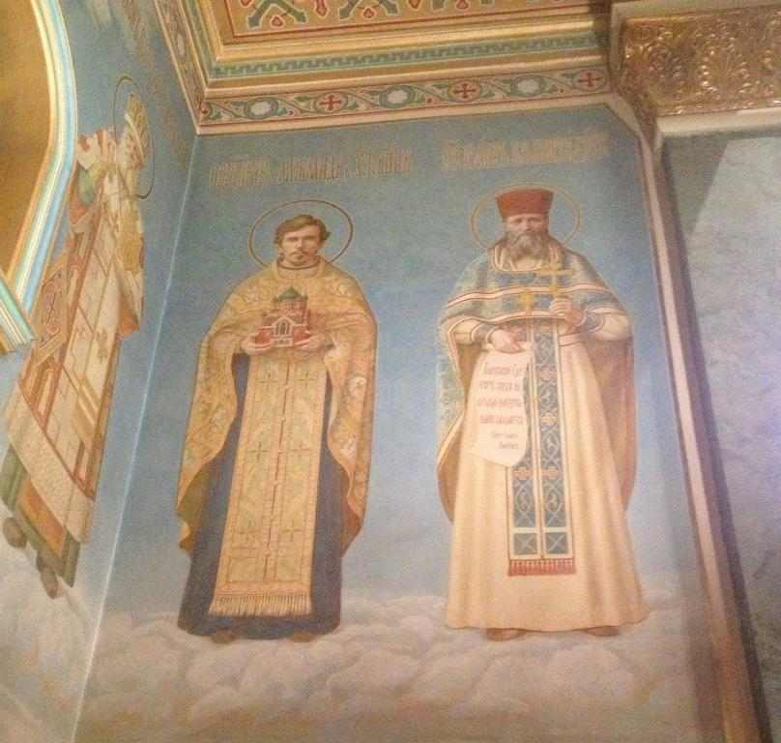
our local saints наши местные святые
Saint Raphael of Brooklyn Святой Рафаэль Бруклинский
Holy Martyr Alexander Schmorell of Munich Святой мученик Александр Шморель Мюнхенский
Saint Alexander Hotovitzky in North America Святой Александр Хотовицкий в Северной Америке
Abbot Nikanor (Savich) in Victoria Игумен Никанор (Савич) в Виктории.

Slide 16
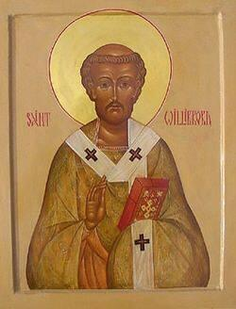
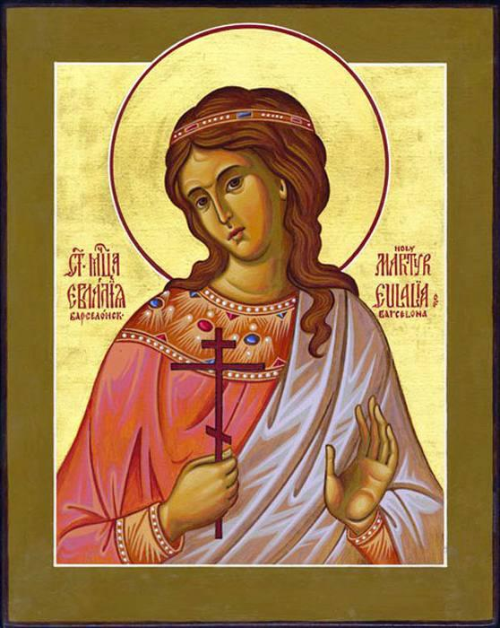
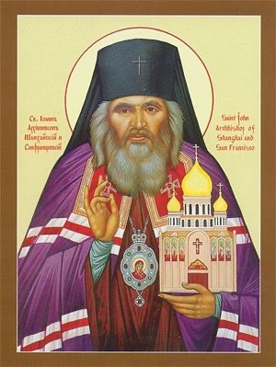
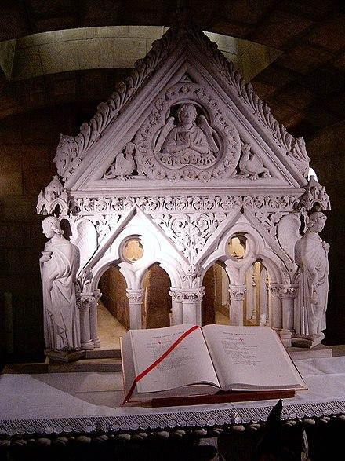
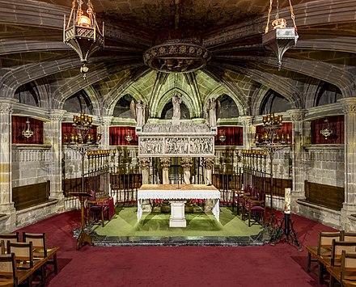
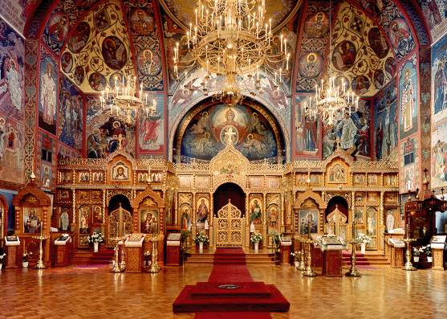
our local saints наши местные святые
Eulalia of Barcelona Евлалия Барселонская
Saint John of Shanghai and San Francisco Иоанн Шанхайский и Сан Францисский
Saint Willibrord Святой Виллиброрд

Slide 17
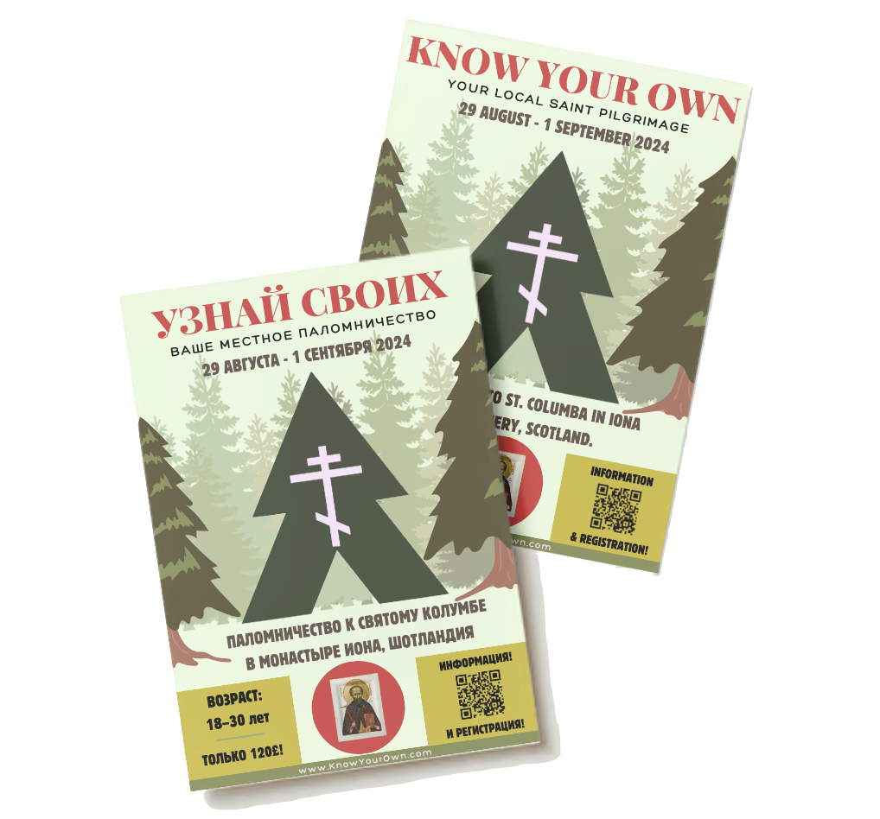
Спасибо за внимание!
Thank you!
ADOYC GROUP 4

