Slide 1



ISSUE: LOSS OF FAITH
How do we preserve Orthodox identity
during teenage years?
Peter Antchoutine, Nikolai Kuprijanov, Masha Lush, Peter Sheslow, Michael Abu-Ali, Marianna Wilkinson,
Daria Skalitzky, and Alexandra (Alecia) Scott

Slide 2
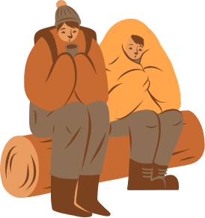




WHAT IS HAPPENING?

Slide 3
WHAT IS HAPPENING?
“Most young people retain the same religious faith and roughly at the same levels of belief and practice when they are 18-23 years-old as when they were teenagers.’’
(Danckaert, 2014)

Slide 4
WHAT CAN WE DO?

Slide 5




RETAINING FAITH
  Parents leading by example
  Church engagement
  Friendship and making new connections
  Fostering a positive environment
  Finding Spiritual Mentors
  Understanding why we practice the faith
  Practicing what you have learned in daily life

Slide 6
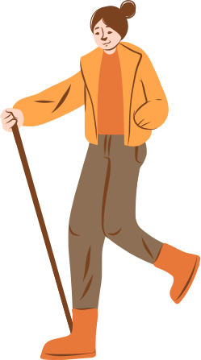




ONE WAY TO RETAIN FAITH:
ORTHODOXY
ENGAGED
WEEKEND CAMP
FOR TEENAGERS
& THEIR PARENTS

Slide 7

PROGRAM
Friday:
  18:00 - Welcome and check-in of the campers
  19:00 - Dinner
  20:00 - Campfire
Saturday:
  8:30 - Moleben
  9:00 - Breakfast
  9:30 - Opening Remarks/First Presentation
  10:30 - Candle making (participants can bring them to church)
  11:30 - Sports (parents and children team together)
  12:30 - Free Time for Socializing
  13:00 - Lunch

Slide 8
PROGRAM
Saturday (cont.):
  13:30 - Separate Presentations for Parents and Teens
  14:30 - Prosfora making
  15:30 - Choir Rehearsal
  17:00 - Vigil
  19:00 - Dinner
Sunday:
  9:00 - Liturgy
  10:30 - Breakfast
  11:00 - Free Time
  12:00 - Arts & Crafts
  13:00 - Closing Remarks - Reflections on Camp
  14:00 - Lunch and Closing

Slide 9


ORGANISATION AND MATERIALS
Organisational team:
  A spiritial leader
  One or two main coordinators
  5-6 volunteers
  A treasurer
  A group of speakers and craftsmen
Materials:
  A transport (a hired bus/car-pulling)
  Food and water with cooking equipment
  Tents if needed
  Liturgical materials
  Workshop equipment
  Sport equipment
  Some nice perks

Slide 10
PLANNING CAMP
Steps to take:
  Decide where you want the camp to be.
  Reserve your campsite.
  Reserve your destination: know what amenities you’ll have and, therefore, what you’ll need to bring.
  Plan your meals.
  Plan your talks and socials.
  Make a packing list

Slide 11

APPROXIMATE BUDGET
(based on 60 people)
Expense Category
Food
Accommodation
Activities
Total:
Total Cost
$2160
$1200
$400
$3760
Cost per Person
$36
$20
$15
$71
nbb
Price per person: $120
Initial profit: $7,200 for 60 person capacity
Net Profit: $3,440

Slide 12

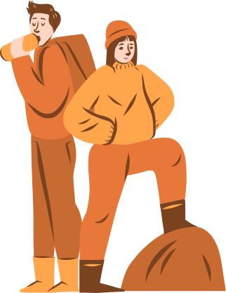

CONTINUED IMPACT
  A greater connection to the Church, and more importantly a better personal relationship with God.
  Building memories that will last and inspire a continuation of the Orthodox Faith.
  Building lifelong connections.

Slide 13
SOURCE
https://blogs.ancientfaith.com/orthodoxyandheterodoxy/2014/04/08/losing-our-religion-on-retaining-young-people-in-the-orthodox-church/

