Slide 1

ROCORoots
Group 1
By: Kyra, Irina, Teya, Anya, Paul, Tyler, Nikolai, Jake, Alesha, and Andrew
Notes:
Tyler

Slide 2
Background
Maintaining a large, thriving and active community has always been deeply-seated in the tradition and history of the Russian Church Abroad. Previous generations emigrating from their homes relied on the church to maintain their sense of community with people of similar traditions while living in a foreign land.
Youth community has always especially been important and a large part of our identity, as can be seen from various regular events such as St. Herman’s Youth Conference, the All-Diaspora Youth Conferences.
Today that spirit remains alive and thriving, as can be seen by how many youths gathered from all across the world today here in Germany.
Notes:
Andrei

Slide 3
What are we doing?
Problem: How do we find a local community within the youth of the Orthodox Church and how can we preserve our Christian identity in relation to the conference topic?
Target Audience: Orthodox Christian youths across the globe who are seeking deeper connections and a stronger youth program through a digital lens
Our Goal: Create a program to better understand Orthodox identity, and to strengthen connection of youths in the Diaspora.
Notes:
Irina

Slide 4
Our Thought Process
How can we help others find and start local youth groups?
What happens when a church doesn’t have the means to start up a youth community within the church of like-minded individuals?
We aim to provide any group interested with resources, connections, and support in getting organized and becoming an active, thriving community.
Notes:
Kyra

Slide 5
Solution
ROCORoots
Our idea is to create an interactive website to promote the creation and growth of youth groups across the Diaspora.
These Youth Groups are essential for creating both an environment and network for the youth to stay strong in their faith and orthodox identity.
Main points include:
DIY Starter Guide for new youth groups
Contact listing
FAQ for starting new youth groups
Embedded video repository
Notes:
Kolya

Slide 6


DIY Starter Guide for building a youth group
Introduction/Inspiration/Advice & Tips
Necessary Rules:
Eg. Receive a blessing from your Priest
Necessary Roles:
Eg. Organizer, Treasurer, Official DJ
Suggested Activities:
Eg. Pilgrimage, Balls, Q&A Session with Priest, Board Games, Movies, etc.
Fundraising Ideas:
Eg. Youth fund, cooking, selling homemade products
Notes:
Tyler

Slide 7


Contact List
Purpose: To promote interparish youth group events and to help the youth be aware of other youth groups both interstate and internationally
Benefits:
Helping Orthodox youth find youth groups near them when during holidays or when moving interstate
Provides inspiration to start youth groups
Help new youth groups contact established ones for advice, ideas, etc.
Promote interparish interactions reducing isolation
Notes:
Andrei

Slide 8
Group Chats/Discord Server
Purpose: To facilitate online interaction and communication, in turn creating a larger, broader sense of community transcending worldly distance.
Method/Logistics:
Invitations/links to join in the local group chats will be readily available on the website, and individual parishes will encourage youth to participate.
Host regular events such as bible studys and include polls, to assist with organising events.
Invite clergy to participate; answering questions and serving as trusted authoritative voices.
Facilitate youth interaction between parishes on a regular basis.
Encourage easy, fast, country-wide communication to encourage collaboration
Notes:
Paul

Slide 9
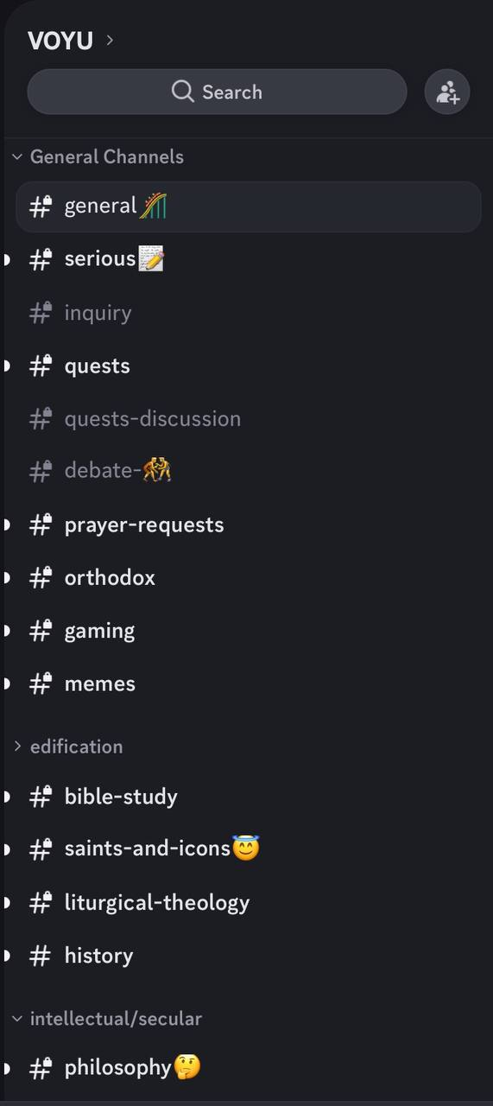
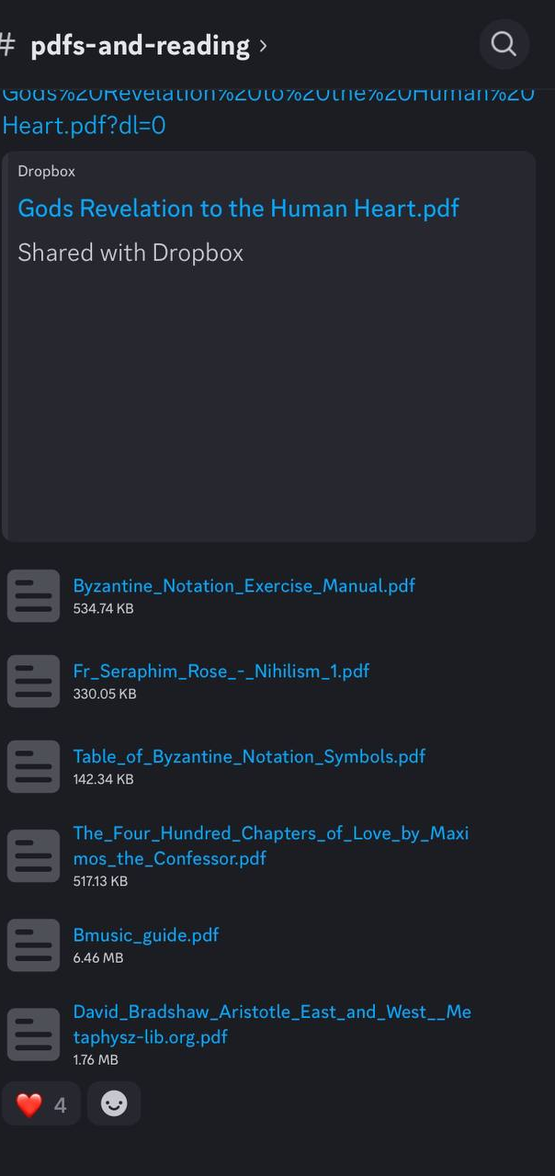
Ideas and Inspiration for a Youth Discord Server
From the VOYU - Varangian Orthodox Youth Union, active in Australia with over 200 members.
Notes:
Paul

Slide 10

Interactive Q&A/FAQ Page
Purpose: Place to see relevant answers to FAQ and to ask new questions related to starting, organizing, managing youth groups
The page will include FAQ at the top with a Google Form underneath which would be updated when new questions come in
A group of experienced youth group organizers and priests would be answering the questions
There will also be links to Telegram/Discord Chats for youth to join
Notes:
Anya

Slide 11
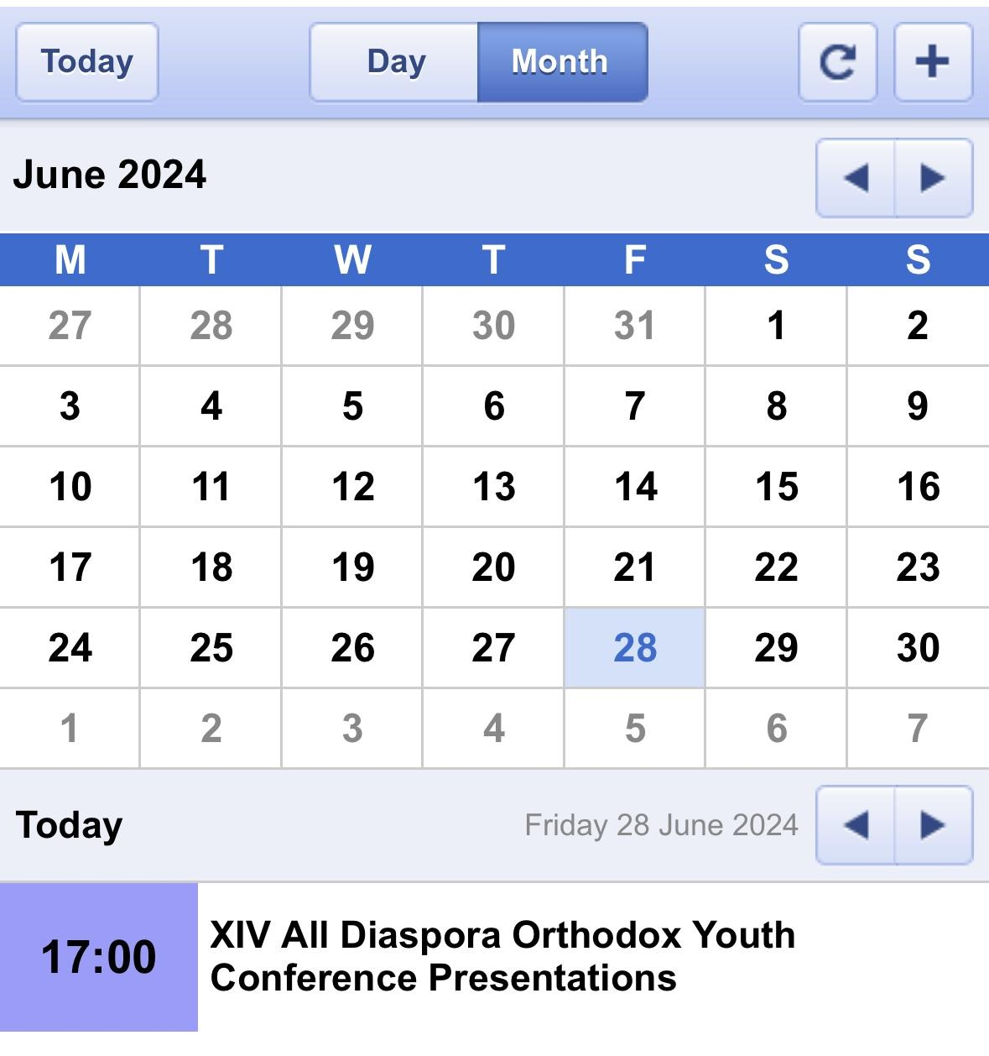
Calendar of Events
Purpose: To promote and advertise youth events. In turn this will raise awareness and popularity of youth events, encourage collaboration and inter-mingling between communities.
Logistics:
Events associated with specific Youth Groups should be published at least one week in advance.
An associated emailing list categorised by location to notify people in advance.
The calendar itself should be able to be filtered by both location and time periods.
A google calendar format.
Notes:
Alex

Slide 12
Implementation
We envision bringing our idea to life through using a hosting service such as Orthodox Web Solutions, whom many of our parishes currently use for their websites.
The project will largely be volunteer-ran and maintained, with the opportunity to expand it to an official diocesan/all-diaspora resource should activity and usage make this appropriate.
Representatives per diocese
Notes:
Jake

Slide 13
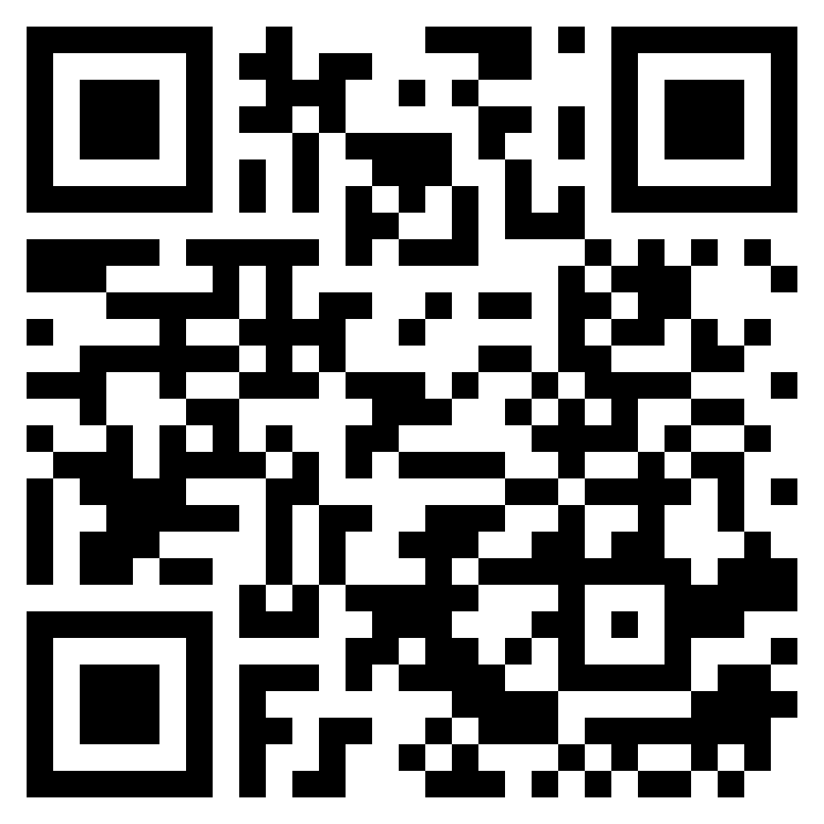
Feedback
Please fill out this brief form!!
Спасибо!!!

